Slide 1

Survey of Career Service Professionals:
Corporate Sector
(career development within a corporation)
January, 2012

Slide 2
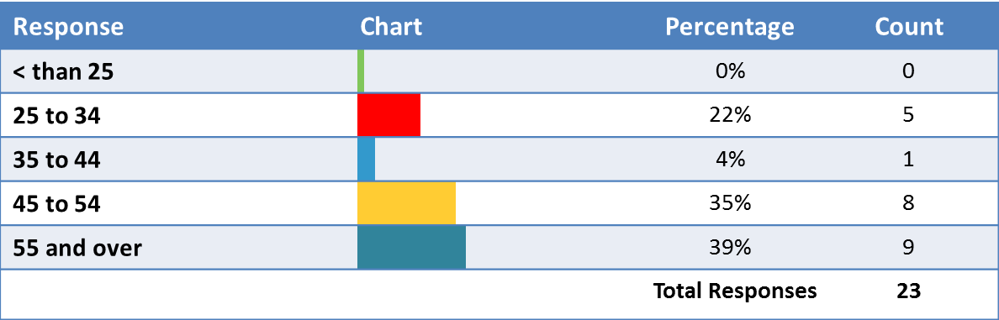
Demographic Information
Age

Slide 3
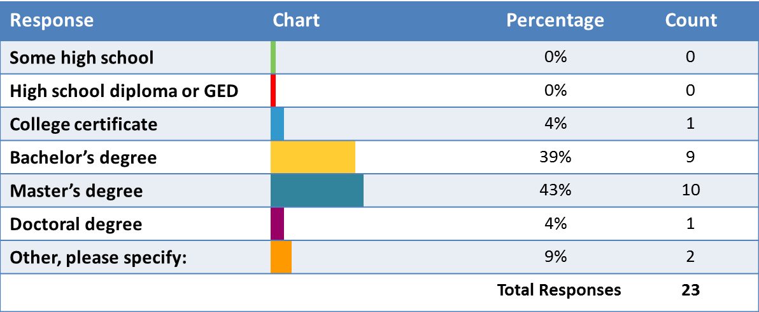
Demographic Information
What is your highest level of education completed?

Slide 4
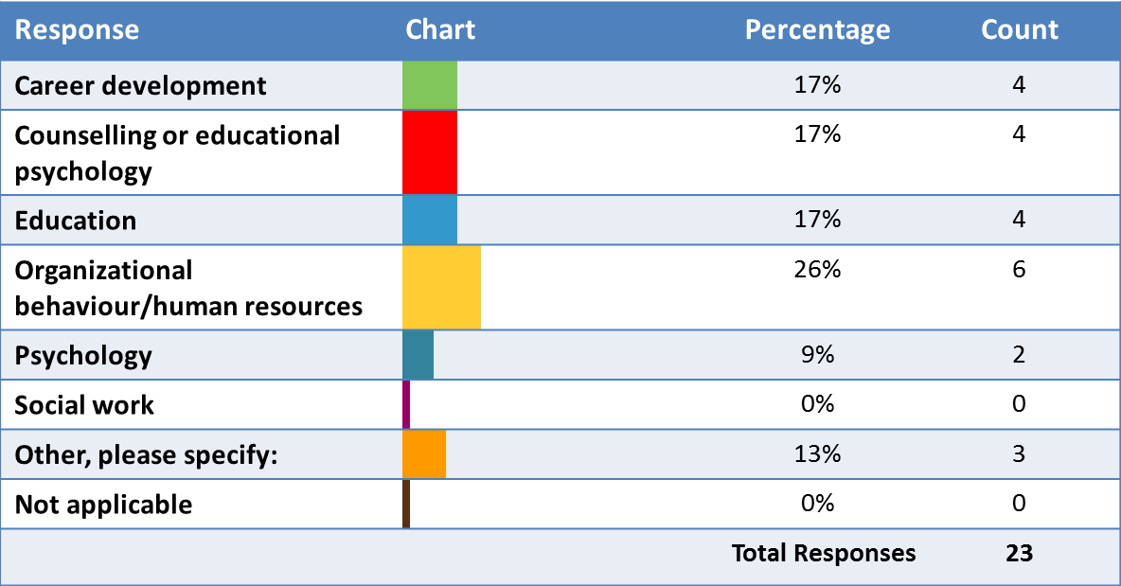
Demographic Information
What was your main area of focus in your highest level of
post-secondary studies applicable to the career services field?

Slide 5
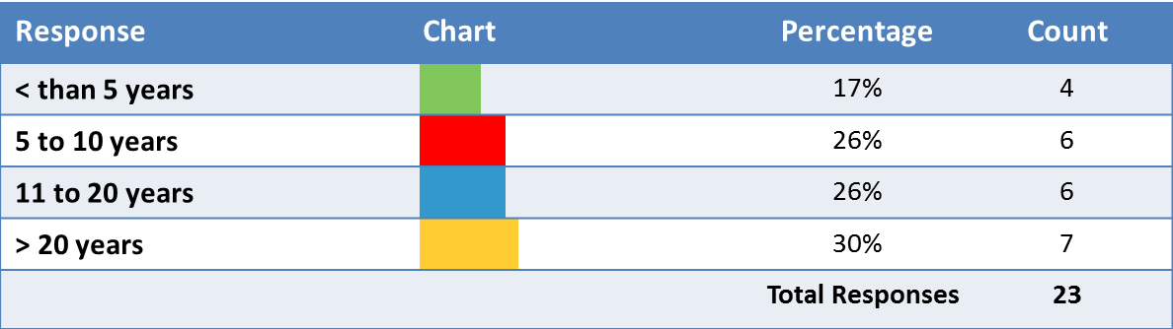
Demographic Information
Years working in career development?

Slide 6
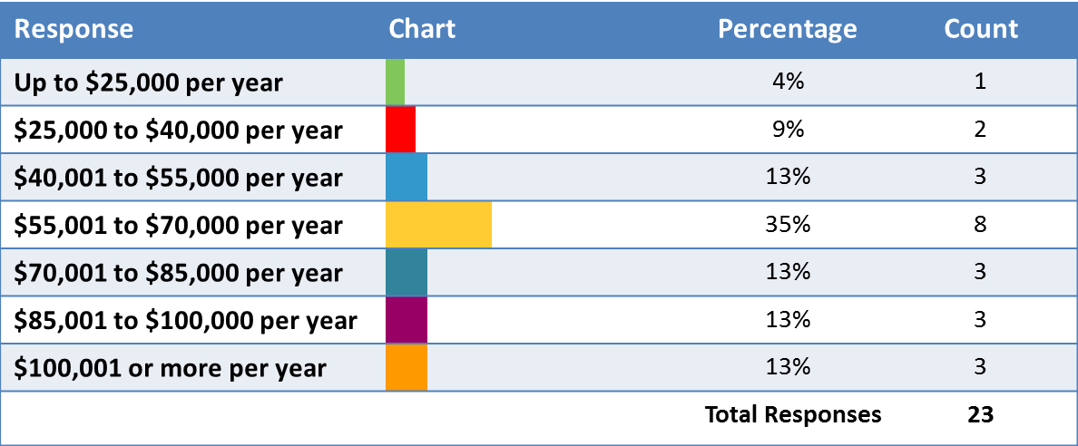
Demographic Information
What is your gross (before deductions) annual salary or income?

Slide 7
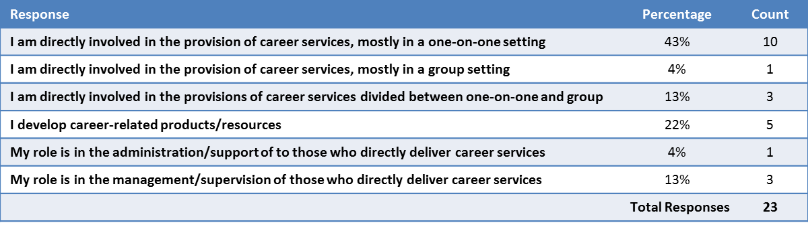
Demographic Information
Which answer BEST describes your job function as it relates to the
career development/career counselling field? (Choose 1 answer)

Slide 8
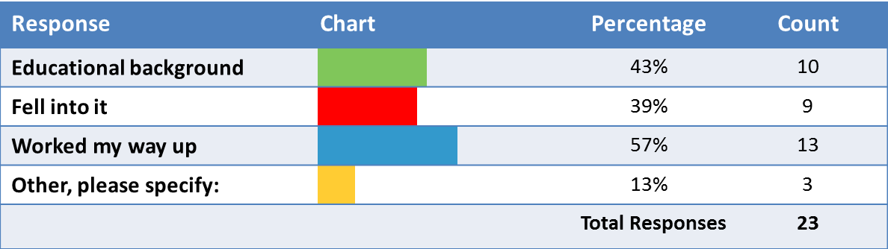
Demographic Information
How did you find yourself working in the career development field? (Select all that apply)

Slide 9
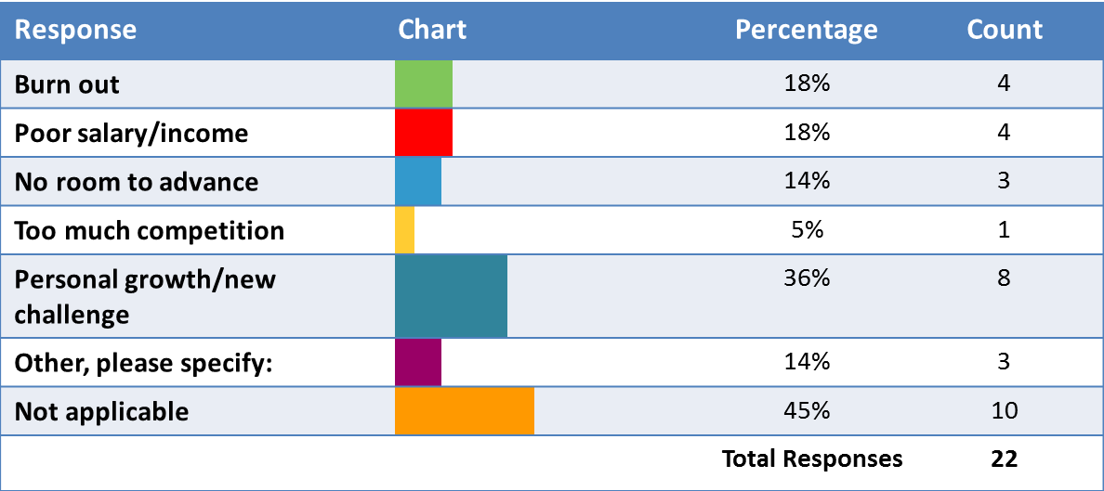
Demographic Information
If you are considering moving to a new field, please indicate the reason. (Select all that apply)

Slide 10
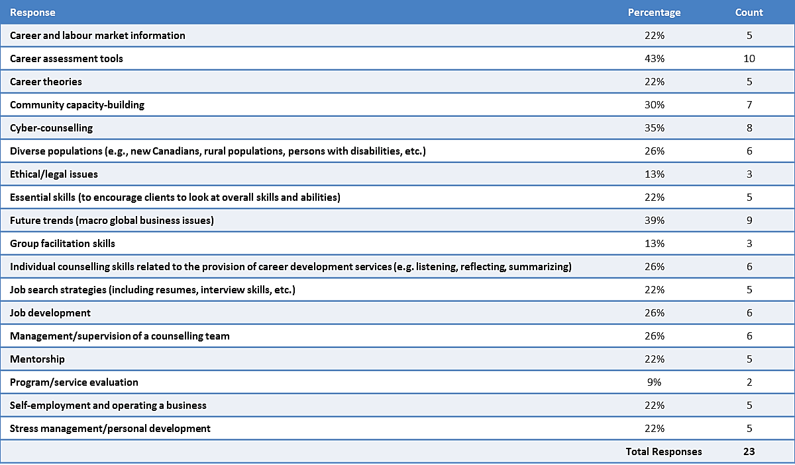
Professional Development and Learning
In which of the following areas would you like to focus your professional development over the next year? (Select up to 5)

Slide 11
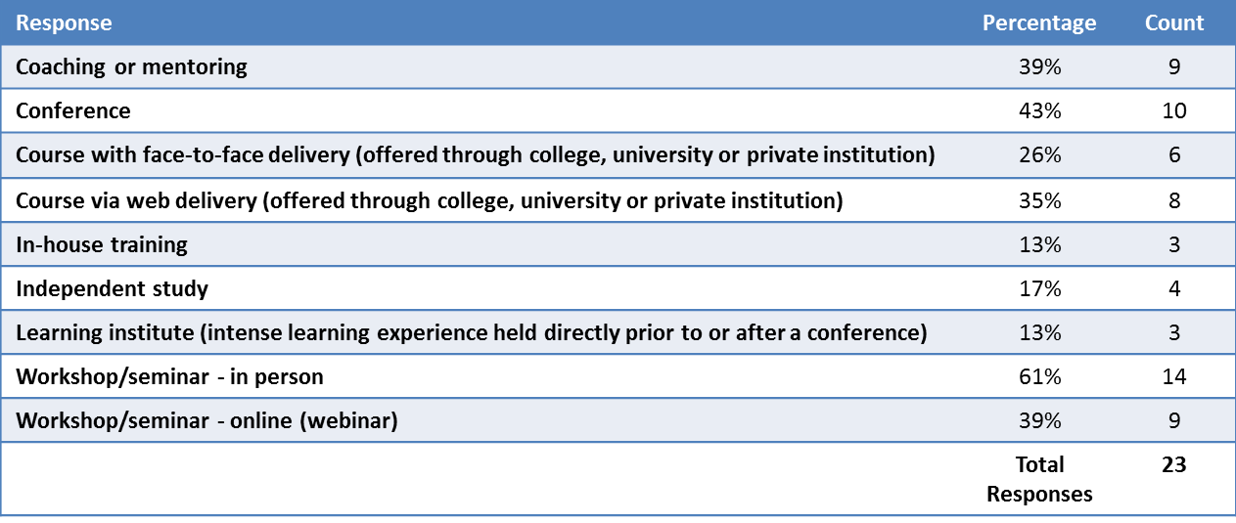
Professional Development and Learning
Thinking about given time constraints and available resources,
what type of training do you prefer? (Select the top 3 that apply)

Slide 12
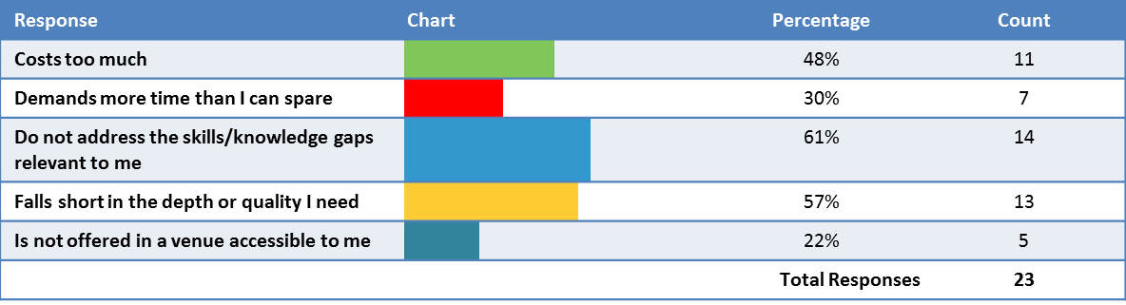
Professional Development and Learning
Given the training opportunities currently available to the field,
which of the following presents the greatest challenge in meeting your training needs ?
(Select the top 3 that apply)

Slide 13
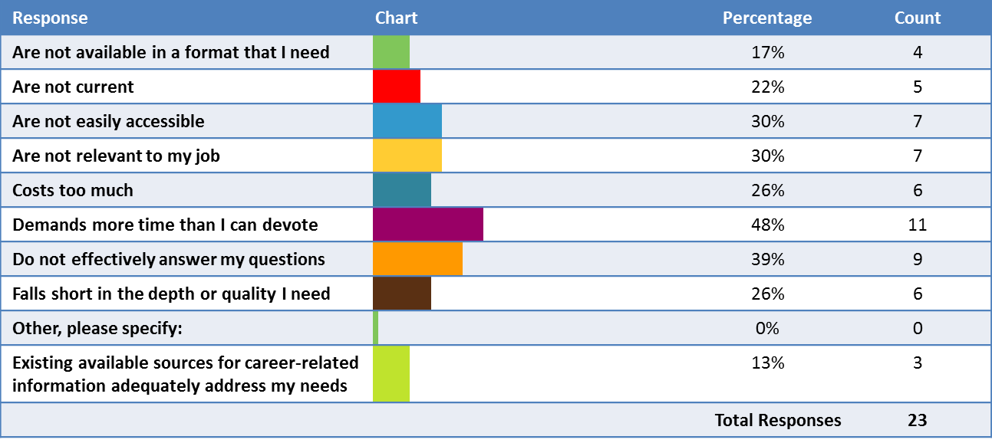
Professional Development and Learning
Given the available sources for career-related information, which of the following has presented you
with the greatest challenge in meeting your research and information needs? (Select the top 3 that apply)

Slide 14
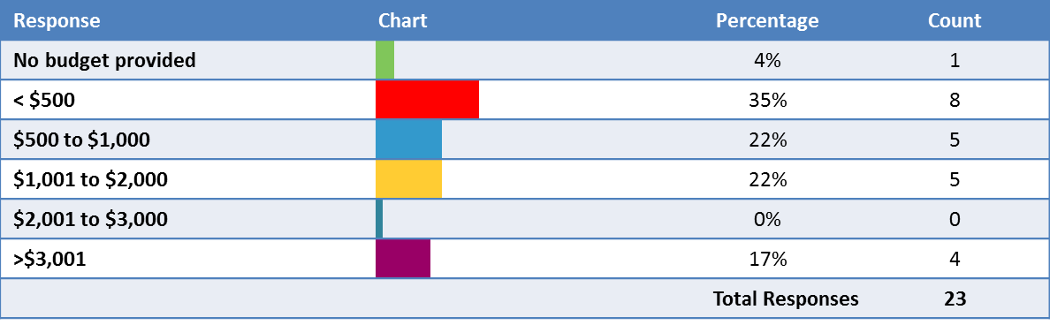
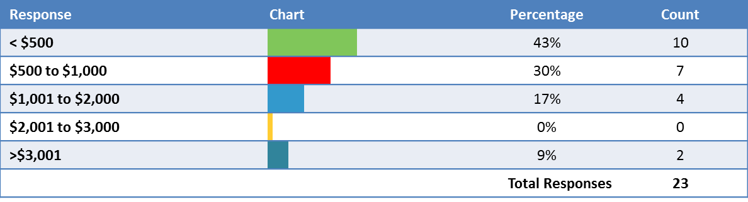
Professional Development and Learning
What is your yearly personal professional development budget?
If an employer were not in a position to cover the costs of your professional development,
how much would you be personally willing to pay for professional development annually?

Slide 15
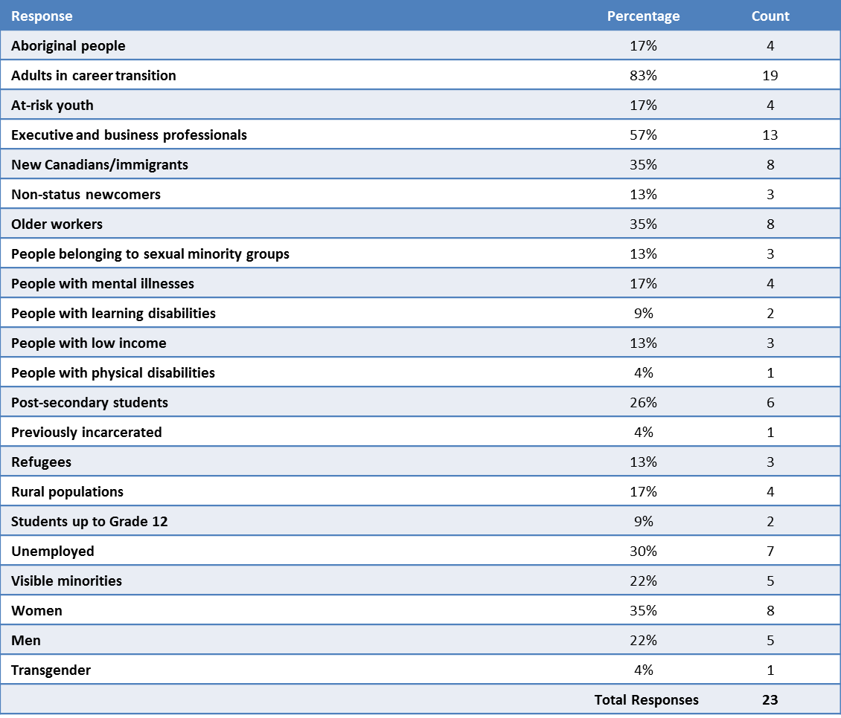
Professional Development and Learning
On which of the following client groups would you most like to focus your professional development? (Select all that apply)

Slide 16
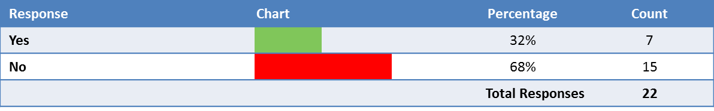
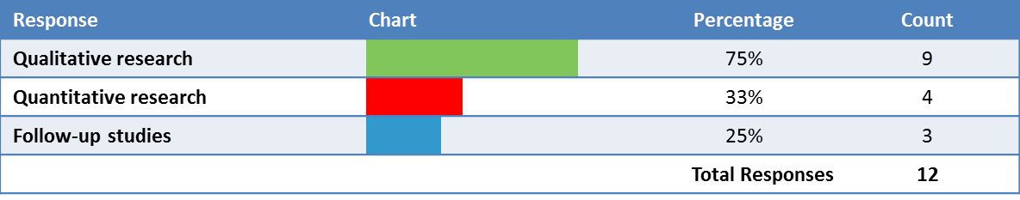
Research
Is your organization involved in career development research?
What types of research are you undertaking? (Select all that apply)

Slide 17
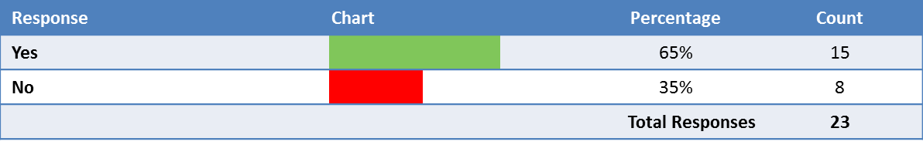
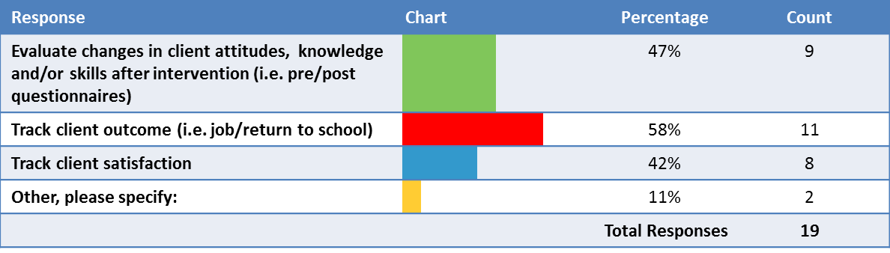
Research
Are you currently evaluating the impact of your career counselling/career development program or services?
If you are currently evaluating your program, what are you focusing upon? (Select all that apply)

Slide 18
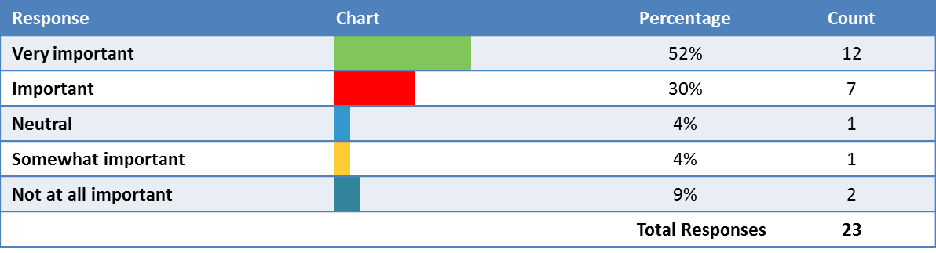
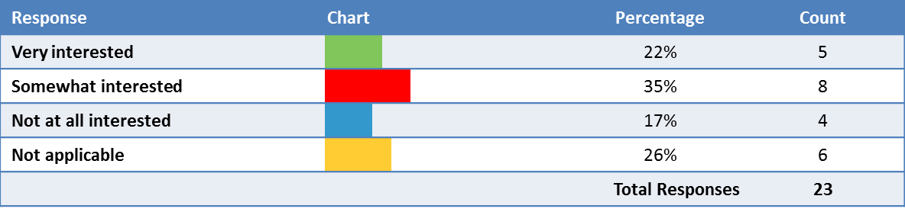
Career Competency/Mobility
How important is being professionally certified to you?
How interested are you in becoming a manager in the field of career development?

Slide 19
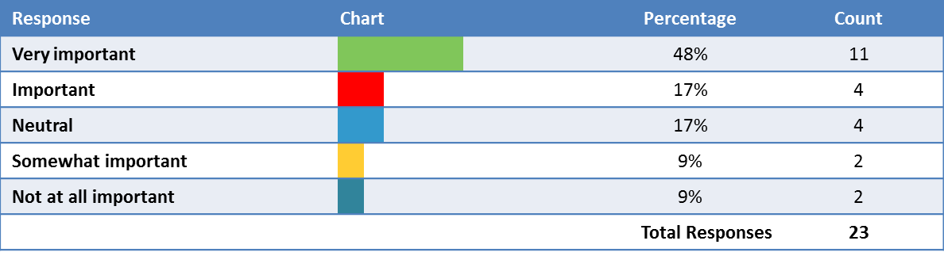
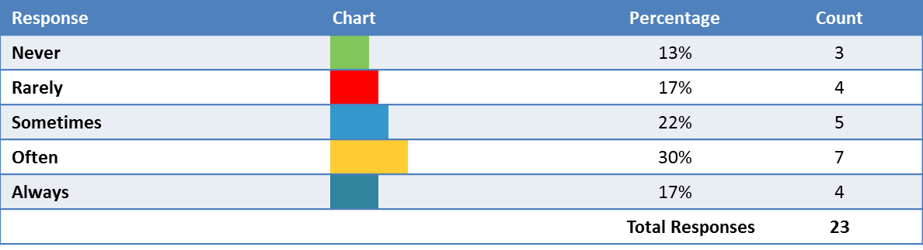
Technology Access and Awareness
How important is social media in terms of the work performed by career service professionals?
How often do you use social media tools for professional purposes?

Slide 20
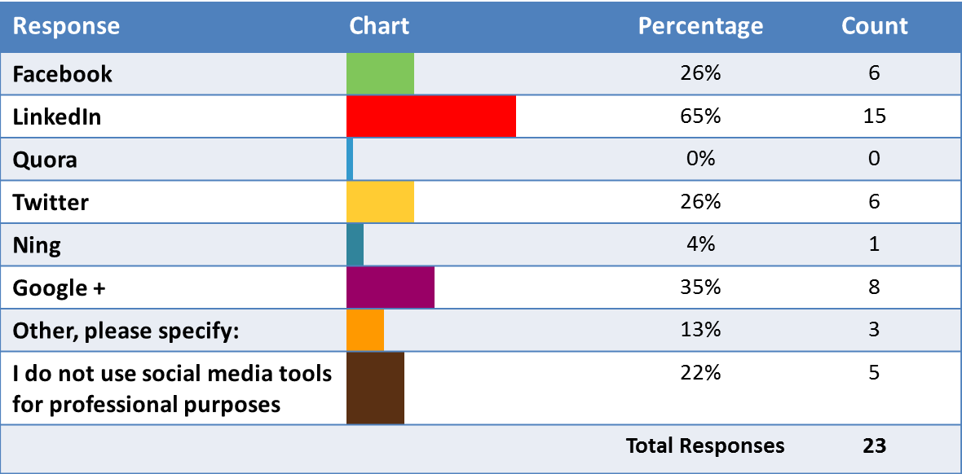
Technology Access and Awareness
What social media tools do you use most often for professional purposes? (Select all that apply)

Slide 21
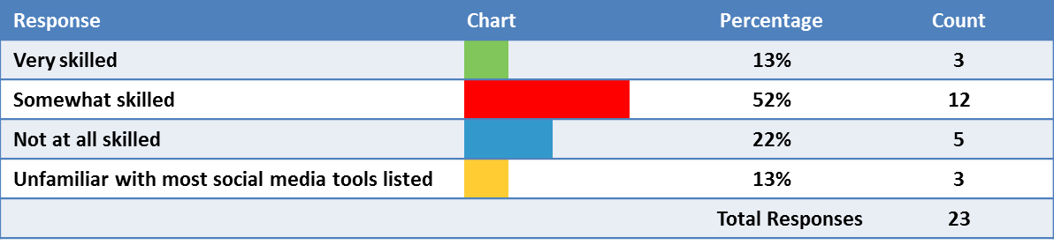
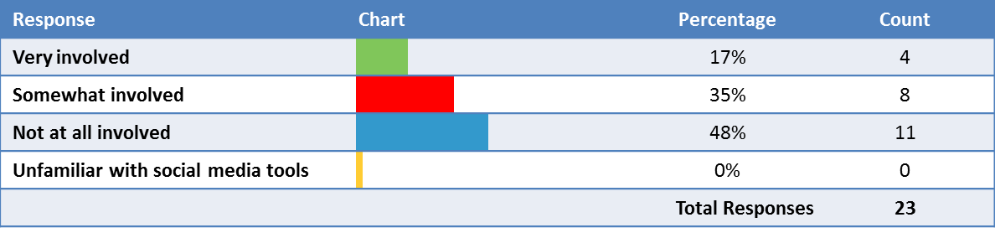
Technology Access and Awareness
How would you rate your skill-level in terms of using social media
(Facebook, LinkedIn, Prezi, Blackboard, Twitter, etc.) as a career development tool?
To what extent are you involved in educating your clients about how to use social media tools?

Slide 22
Survey of Career Service Professionals
Please visit the CERIC website to download the Survey of Career Service Professionals Highlights Report (available in English and French)
and other information documents.

